Slide 1
Data Mining Classification: Decision Tree Induction, ID3, C 4.5, CART
Week2 Lecture 1
By Eesha Tur Razia Babar

Slide 2
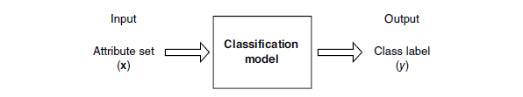
Classification: Definition
Given a collection of records (training set )
Each record is by characterized by a tuple (x,y), where x is the attribute set and y is the class label
x: attribute, predictor, independent variable, input
y: class, response, dependent variable, output
Task:
Learn a model that maps each attribute set x into one of the predefined class labels y
Notes:
Classification, which is the task of assigning objects to one of several predefined
categories,
Classification is the task of learning a target function f that maps each attribute set x to one of the predefined class labels y.
The target function is also known informally as a classification model. A classification model is useful for the following purposes.

Slide 3
Examples of Classification Task
Task | Attribute set, x | Class label, y
Categorizing email messages | Features extracted from email message header and content | spam or non-spam
Identifying tumor cells | Features extracted from x-rays or MRI scans | malignant or benign cells
Cataloging galaxies | Features extracted from telescope images | Elliptical, spiral, or irregular-shaped galaxies
Notes:
Although the attributes are mostly discrete, the attribute set can also contain continuous
features. The class label, on the other hand, must be a discrete attribute.
This is a key characteristic that distinguishes classification from regression,
a predictive modeling task in which y is a continuous attribute. Regression
techniques are covered in Appendix D.

Slide 4
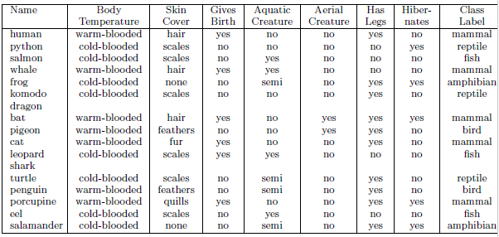
Descriptive Modeling
A classification model can serve as an explanatory
tool to distinguish between objects of different classes.
Notes:
A classification model can serve as an explanatory
tool to distinguish between objects of different classes. For example, it would
be useful—for both biologists and others—to have a descriptive model that

Slide 5

Predictive Modeling
A classification model can also be used to predict
the class label of unknown records. A classification
model can be treated as a black box that assigns a class label when presented with the attribute set of an unknown record.
Notes:
Classification techniques are most suited for predicting or describing data
sets with binary or nominal categories. They are less effective for ordinal
categories (e.g., to classify a person as a member of high-, medium-, or lowincome
group) because they do not consider the implicit order among the
categories. Other forms of relationships, such as the subclass–superclass relationships
among categories (e.g., humans and apes are primates, which in

Slide 6
General Approach for Building Classification Model
Notes:
A classification technique (or classifier) is a systematic approach to building
classification models from an input data set. Examples include decision tree
classifiers, rule-based classifiers, neural networks, support vector machines,
and na¨ıve Bayes classifiers. Each technique employs a learning algorithm
to identify a model that best fits the relationship between the attribute set and
class label of the input data. The model generated by a learning algorithm
should both fit the input data well and correctly predict the class labels of
records it has never seen before. Therefore, a key objective of the learning
algorithm is to build models with good generalization capability; i.e., models
that accurately predict the class labels of previously unknown records.

Slide 7
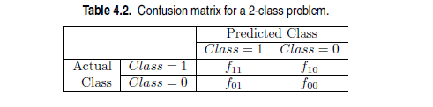
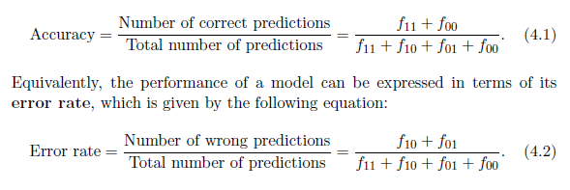
Performance Metrics
Notes:
Evaluation of the performance of a classification model is based on the
counts of test records correctly and incorrectly predicted by the model. These
counts are tabulated in a table known as a confusion matrix

Slide 8
Classification Techniques
Base Classifiers
Decision Tree based Methods
Rule-based Methods
Nearest-neighbor
Naïve Bayes and Bayesian Belief Networks
Support Vector Machines
Neural Networks, Deep Neural Nets
Ensemble Classifiers
Boosting, Bagging, Random Forests

Slide 9
Example of a Decision Tree
categorical
categorical
continuous
class
Splitting Attributes
Home Owner
Yes
No
NO
MarSt
Single, Divorced
Married
Income
NO
< 80K
> 80K
NO
YES
Training Data
Model: Decision Tree
Notes:
To illustrate how the algorithm works, consider the problem of predicting
whether a loan applicant will repay her loan obligations or become delinquent,
subsequently defaulting on her loan. A training set for this problem can be
constructed by examining the records of previous borrowers. In the example
shown in Figure 4.6, each record contains the personal information of a borrower
along with a class label indicating whether the borrower has defaulted
on loan payments.

Slide 10
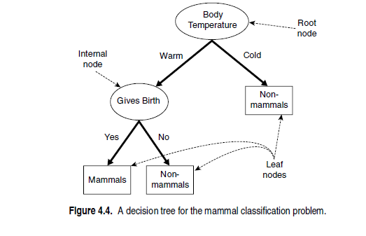
EXAMPLE
Notes:
• A root node that has no incoming edges and zero or more outgoing
edges.
• Internal nodes, each of which has exactly one incoming edge and two
or more outgoing edges.
• Leaf or terminal nodes, each of which has exactly one incoming edge
and no outgoing edges.
In a decision tree, each leaf node is assigned a class label. The nonterminal
nodes, which include the root and other internal nodes, contain
attribute test conditions to separate records that have different characteristics.
For example, the root node shown in Figure 4.4 uses the attribute Body
Temperature to separate warm-blooded from cold-blooded vertebrates. Since
all cold-blooded vertebrates are non-mammals, a leaf node labeled Non-mammals
is created as the right child of the root node. If the vertebrate is warm-blooded,
a subsequent attribute, Gives Birth, is used to distinguish mammals from
other warm-blooded creatures, which are mostly birds.

Slide 11
Apply Model to Test Data
Test Data
Start from the root of tree.
Home Owner
Yes
No
NO
MarSt
Single, Divorced
Married
Income
NO
< 80K
> 80K
NO
YES

Slide 12
Apply Model to Test Data
Test Data
Home Owner
Yes
No
NO
MarSt
Single, Divorced
Married
Income
NO
< 80K
> 80K
NO
YES

Slide 13
Apply Model to Test Data
Test Data
Home Owner
Yes
No
NO
MarSt
Single, Divorced
Married
Income
NO
< 80K
> 80K
NO
YES

Slide 14
Apply Model to Test Data
Test Data
Home Owner
Yes
No
NO
MarSt
Single, Divorced
Married
Income
NO
< 80K
> 80K
NO
YES

Slide 15
Apply Model to Test Data
Test Data
Home Owner
Yes
No
NO
MarSt
Single, Divorced
Married
Income
NO
< 80K
> 80K
NO
YES

Slide 16
Apply Model to Test Data
Test Data
Home Owner
Yes
No
NO
MarSt
Single, Divorced
Married
Assign Defaulted to “No”
Income
NO
< 80K
> 80K
NO
YES

Slide 17
Another Example of Decision Tree
categorical
categorical
continuous
class
Single, Divorced
MarSt
Married
NO
Home Owner
Yes
No
NO
Income
< 80K
> 80K
NO
YES
There could be more than one tree that fits the same data!

Slide 18
Decision Tree Classification Task
Decision Tree

Slide 19
Decision Tree Induction (How to build a decision tree)
Many Algorithms:
Hunt’s Algorithm (one of the earliest) which is the basis of the following algorithms.
CART
ID3, C4.5
SLIQ, SPRINT
Notes:
In principle, there are exponentially many decision trees that can be constructed
from a given set of attributes. While some of the trees are more accurate
than others, finding the optimal tree is computationally infeasible because
of the exponential size of the search space. Nevertheless, efficient algorithms
have been developed to induce a reasonably accurate, albeit suboptimal, decision
tree in a reasonable amount of time. These algorithms usually employ
a greedy strategy that grows a decision tree by making a series of locally op-timum decisions about which attribute to use for partitioning the data

Slide 20
Greedy Algorithms
In computer science, a greedy algorithm is an algorithm that finds a solution to problems in the shortest time possible. It picks the path that seems optimal at the moment without regard for the overall optimization of the solution that would be formed
One such algorithm is Hunt’s algorithm, which is the basis of many existing decision tree induction algorithms, including ID3, C4.5, and CART

Slide 21
General Structure of Hunt’s Algorithm
Let D_{t} be the set of training records that reach a node t
General Procedure:
If D_{t} contains records that belong the same class y_{t}, then t is a leaf node labeled as y_{t}
If D_{t} contains records that belong to more than one class, use an attribute test to split the data into smaller subsets. Recursively apply the procedure to each subset.
D_{t}
?
Notes:
In Hunt’s algorithm, a decision tree is grown in a recursive fashion by partitioning
the training records into successively purer subsets. Let Dt be the set
of training records that are associated with node t and y = {y1, y2, . . . , yc} be
the class labels. The following is a recursive definition of Hunt’s algorithm.

Slide 22
Hunt’s Algorithm
(7,3)
(3,0)
(4,3)
(3,0)
(3,0)
(3,0)
(1,3)
(3,0)
(1,0)
(0,3)
Notes:
The initial tree for the classification problem contains a single node with
class label Defaulted = No (see Figure 4.7(a)), which means that most of
the borrowers successfully repaid their loans. The tree, however, needs to be
refined since the root node contains records from both classes.

Slide 23
Hunt’s Algorithm
(7,3)
(3,0)
(4,3)
(3,0)
(3,0)
(3,0)
(1,3)
(3,0)
(1,0)
(0,3)

Slide 24
Hunt’s Algorithm
(7,3)
(3,0)
(4,3)
(3,0)
(3,0)
(3,0)
(1,3)
(3,0)
(1,0)
(0,3)

Slide 25
Hunt’s Algorithm
(7,3)
(3,0)
(4,3)
(3,0)
(3,0)
(3,0)
(1,3)
(3,0)
(1,0)
(0,3)

Slide 26
Special Case 1:
It is possible for some of the child nodes created in Step 2 to be empty; i.e., there are no records associated with these nodes. This can happen if none of the training records have a combination of attribute values associated with such nodes. In this case, the node is declared a leaf node with the same class label as the majority class of training records associated with its parent node.
Notes:
This can happen if none of the training records have a combination of attribute values associated with such nodes. In this case, the node is declared a leaf node with the same class label as the majority class of training records associated with its parent node.

Slide 27
Special Case 2:
In Step 2, if all the records associated with Dt have identical attribute values (except for the class label), then it is not possible to split these records any further. In this case, the node is declared a leaf node with the same class label as the majority class of training records associated with this node.

Slide 28
Design Issues of Decision Tree Induction
How should training records be split?
Method for expressing test condition
depending on attribute types
Measure for evaluating the goodness of a test condition
How should the splitting procedure stop?
Stop splitting if all the records belong to the same class or have identical attribute values
Early termination
Notes:
Each recursive step
of the tree-growing process must select an attribute test condition to
divide the records into smaller subsets. To implement this step, the
algorithm must provide a method for specifying the test condition for
different attribute types as well as an objective measure for evaluating
the goodness of each test condition.
A stopping condition is
needed to terminate the tree-growing process. A possible strategy is to
continue expanding a node until either all the records belong to the same
class or all the records have identical attribute values. Although both
conditions are sufficient to stop any decision tree induction algorithm,
other criteria can be imposed to allow the tree-growing procedure to
terminate earlier.

Slide 29
Methods for Expressing Test Conditions
Depends on attribute types
Binary
Nominal
Ordinal
Continuous
Notes:
Decision tree induction algorithms must provide a method for expressing an
attribute test condition and its corresponding outcomes for different attribute
types.

Slide 30
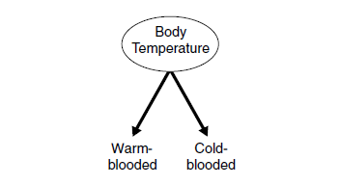
Test Condition for Binary Attribute
The test condition for a binary attribute generates two potential outcomes.

Slide 31
Test Condition for Nominal Attributes
Multi-way split:
Use as many partitions as distinct values.
Binary split:
Divides values into two subsets
Notes:
Since a nominal attribute can have many values, its
test condition can be expressed in two ways, as shown in Figure 4.9. For
a multiway split (Figure 4.9(a)), the number of outcomes depends on the
number of distinct values for the corresponding attribute. For example, if
an attribute such as marital status has three distinct values—single, married,
or divorced—its test condition will produce a three-way split. On the other
hand, some decision tree algorithms, such as CART, produce only binary splits
by considering all 2k−1 − 1 ways of creating a binary partition of k attribute
values.

Slide 32
Test Condition for Ordinal Attributes
Multi-way split:
Use as many partitions as distinct values
Binary split:
Divides values into two subsets
Preserve order property among attribute values
This grouping violates order property
Notes:
Ordinal attributes can also produce binary or multiway
splits. Ordinal attribute values can be grouped as long as the grouping does
not violate the order property of the attribute values

Slide 33
Test Condition for Continuous Attributes

Slide 34
Splitting Based on Continuous Attributes
Different ways of handling
Discretization to form an ordinal categorical attribute
Ranges can be found by equal interval bucketing, equal frequency bucketing (percentiles), or clustering.
Static – discretize once at the beginning
Dynamic – repeat at each node
Binary Decision: (A < v) or (A ≥ v)
consider all possible splits and finds the best cut
can be more compute intensive

Slide 35
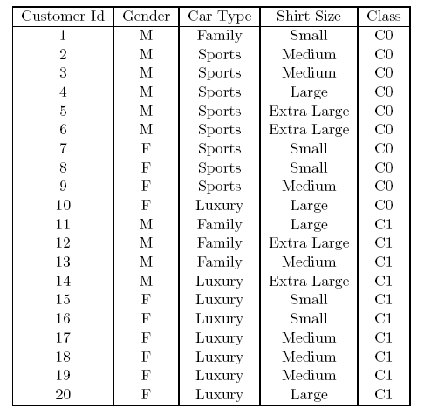
How to determine the Best Split
Before Splitting: 10 records of class 0, 10 records of class 1
Which test condition is the best?

Slide 36
How to determine the Best Split
Greedy approach:
Nodes with purer class distribution are preferred
Need a measure of node impurity:
High degree of impurity
Low degree of impurity
Notes:
The measures developed for selecting the best split are often based on the
degree of impurity of the child nodes. The smaller the degree of impurity, the
more skewed the class distribution. For example, a node with class distribution
(0, 1) has zero impurity, whereas a node with uniform class distribution
(0.5, 0.5) has the highest impurity

Slide 37
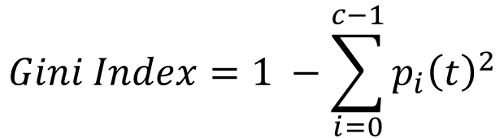
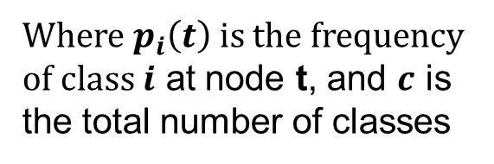
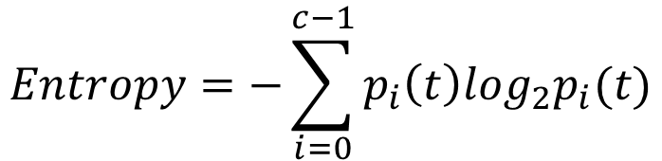
Measures of Node Impurity
Gini Index
Entropy
Misclassification error
$$Gini Index=1 −\sum_{i=0}^{c−1}{p_{i}{\left(t\right)}^{2}}$$
Where $p_{i}\left(t\right)$ is the frequency of class $i$ at node t, and $c$ is the total number of classes
$$Entropy=−\sum_{i=0}^{c−1}{p_{i}\left(t\right)log_{2}p_{i}(t)}$$
$$Classification error={1 −max⁡[p}_{i}(t)]$$
Notes:
where c is the number of classes and 0 log2 0 = 0 in entropy calculations.

Slide 38
Finding the Best Split
Compute impurity measure (P) before splitting
Compute impurity measure (M) after splitting
Compute impurity measure of each child node
M is the weighted impurity of child nodes
Choose the attribute test condition that produces the highest gain
Gain = P - M or equivalently, lowest impurity measure after splitting (M)

Slide 39
Finding the Best Split
Before Splitting:
P
A?
B?
Yes
No
Yes
No
Node N1
Node N2
Node N3
Node N4
M11
M12
M21
M22
M1
M2
Gain = P – M1 vs P – M2

Slide 40
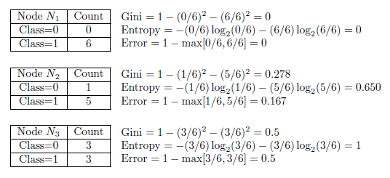
Compute Impurity Measures

Slide 41
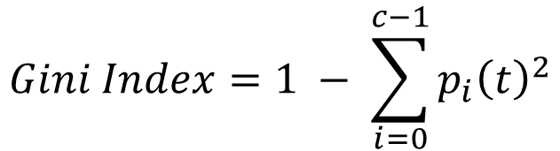
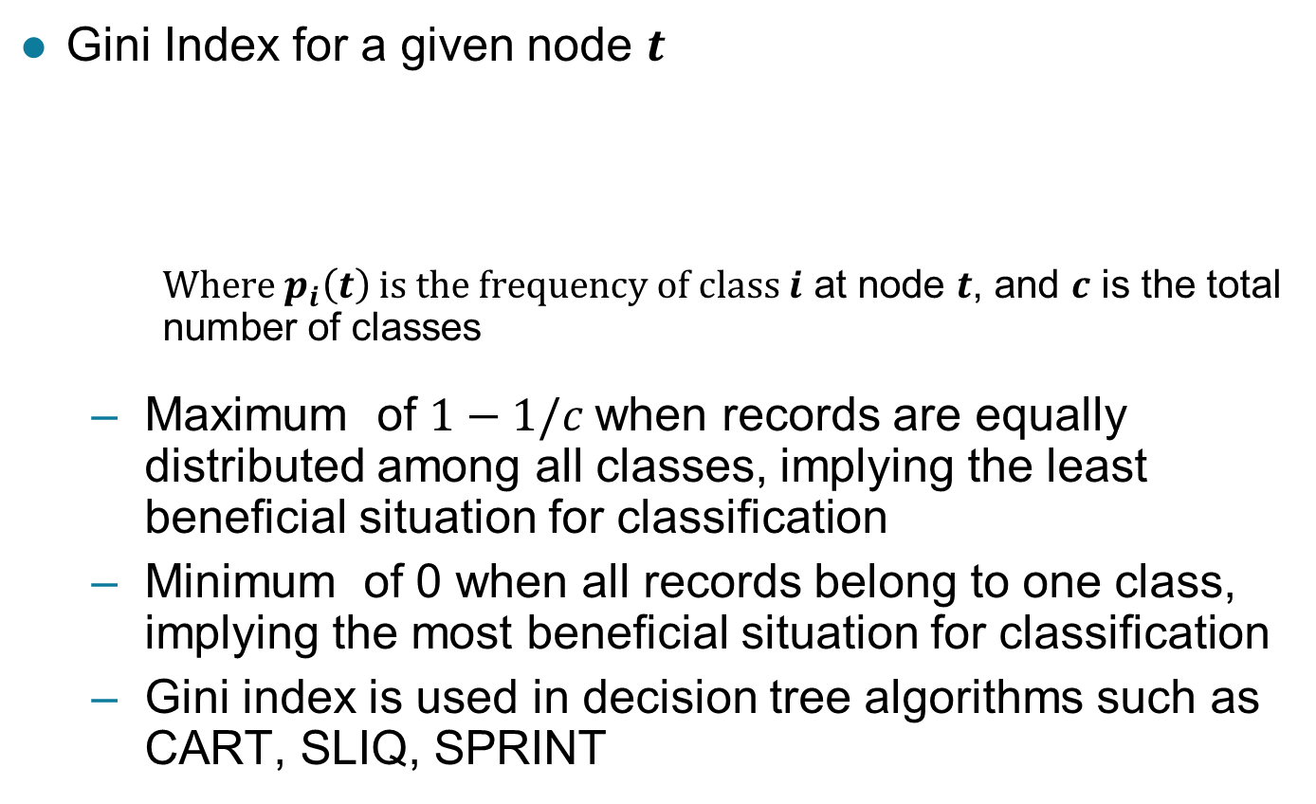
Measure of Impurity: GINI
Gini Index for a given node $t$
Where $p_{i}\left(t\right)$ is the frequency of class $i$ at node $t$, and $c$ is the total number of classes
Maximum of $1−1/c$when records are equally distributed among all classes, implying the least beneficial situation for classification
Minimum of 0 when all records belong to one class, implying the most beneficial situation for classification
Gini index is used in decision tree algorithms such as CART, SLIQ, SPRINT
$$Gini Index=1 − \sum_{i=0}^{c−1}{p_{i}{\left(t\right)}^{2}}$$

Slide 42
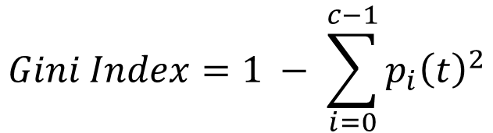
Measure of Impurity: GINI
Gini Index for a given node t :
For 2-class problem (p, 1 – p):
GINI = 1 – p² – (1 – p)² = 2p (1-p)
$$Gini Index=1 − \sum_{i=0}^{c−1}{p_{i}{\left(t\right)}^{2}}$$

Slide 43
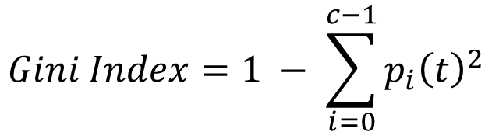
Computing Gini Index of a Single Node
$$Gini Index=1 − \sum_{i=0}^{c−1}{p_{i}{\left(t\right)}^{2}}$$
P(C1) = 0/6 = 0 P(C2) = 6/6 = 1
Gini = 1 – P(C1)² – P(C2)² = 1 – 0 – 1 = 0
P(C1) = 1/6 P(C2) = 5/6
Gini = 1 – (1/6)² – (5/6)² = 0.278
P(C1) = 2/6 P(C2) = 4/6
Gini = 1 – (2/6)² – (4/6)² = 0.444

Slide 44

Information Gain
To determine how well a test condition performs, we need to compare the degree of impurity of the parent node (before splitting) with the degree of impurity of the child nodes (after splitting). The larger their difference, the better the test condition.

Slide 45
Binary Attributes: Computing Information Gain
B?
Yes
No
Node N1
Node N2
Gini(N1) = 1 – (5/6)² – (1/6)² = 0.278
Gini(N2) = 1 – (2/6)² – (4/6)² = 0.444
Weighted Gini of N1 N2 = 6/12 * 0.278 + 6/12 * 0.444 = 0.361
Gain = 0.486 – 0.361 = 0.125
Notes:
Since I(parent) is the same for all test conditions, maximizing the gain is
equivalent to minimizing the weighted average impurity measures of the child
nodes. Finally, when entropy is used as the impurity measure in Equation 4.6,
the difference in entropy is known as the information gain, Δinfo.

Slide 46
Categorical Attributes: Computing Gini Index
For each distinct value, gather counts for each class in the dataset
Use the count matrix to make decisions
Multi-way split
Two-way split
(find best partition of values)
Which of these is the best?

Slide 47
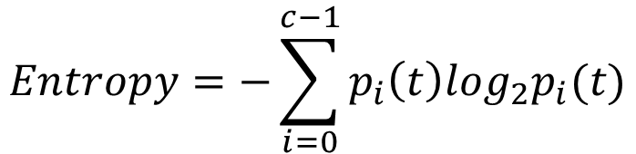
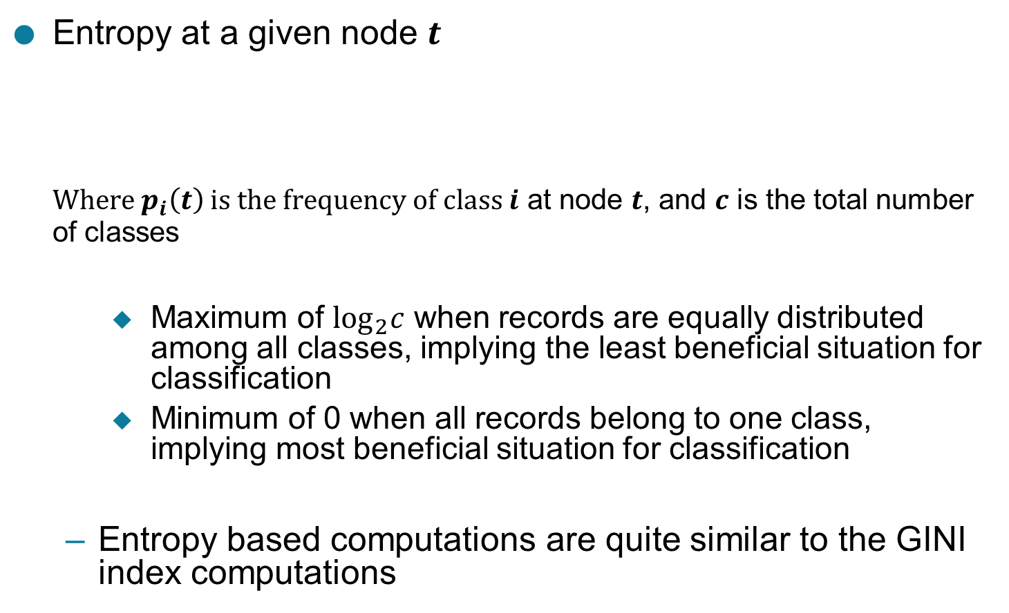
Measure of Impurity: Entropy
Entropy at a given node $t$
Where $p_{i}\left(t\right)$ is the frequency of class $i$ at node $t$, and $c$ is the total number of classes
Maximum of $\log_{2}c$ when records are equally distributed among all classes, implying the least beneficial situation for classification
Minimum of 0 when all records belong to one class, implying most beneficial situation for classification
Entropy based computations are quite similar to the GINI index computations
$$Entropy=−\sum_{i=0}^{c−1}{p_{i}\left(t\right)log_{2}p_{i}(t)}$$

Slide 48
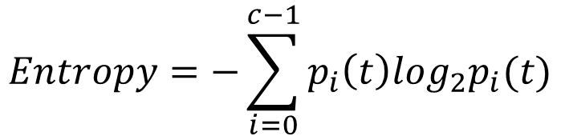
Computing Entropy of a Single Node
$$Entropy=−\sum_{i=0}^{c−1}{p_{i}\left(t\right)log_{2}p_{i}(t)}$$
P(C1) = 0/6 = 0 P(C2) = 6/6 = 1
Entropy = – 0 log 0 – 1 log 1 = – 0 – 0 = 0
P(C1) = 1/6 P(C2) = 5/6
Entropy = – (1/6) log₂ (1/6) – (5/6) log₂ (1/6) = 0.65
P(C1) = 2/6 P(C2) = 4/6
Entropy = – (2/6) log₂ (2/6) – (4/6) log₂ (4/6) = 0.92

Slide 49
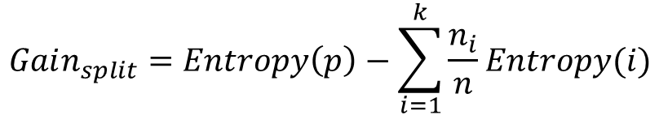
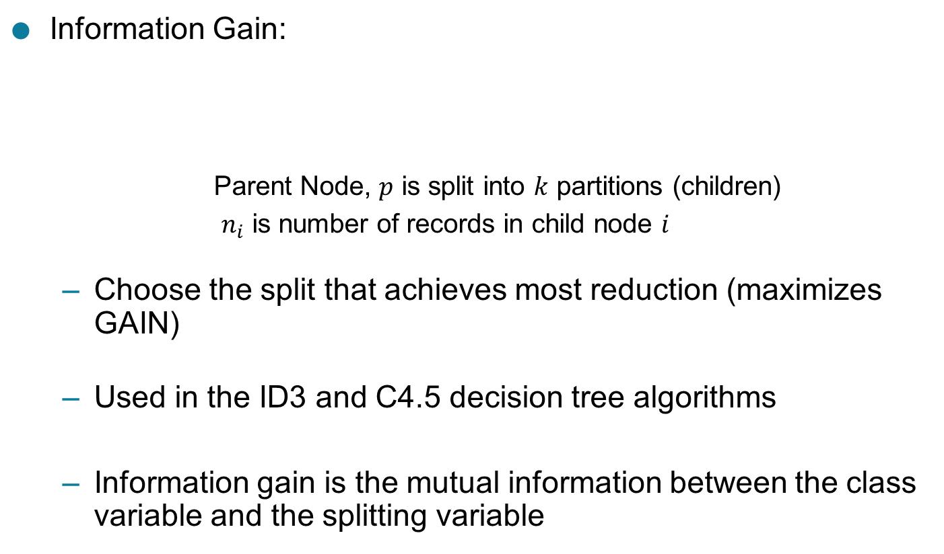
Computing Information Gain After Splitting
Information Gain:
Parent Node, $p$ is split into $k$ partitions (children)
$n_{i}$ is number of records in child node $i$
Choose the split that achieves most reduction (maximizes GAIN)
Used in the ID3 and C4.5 decision tree algorithms
Information gain is the mutual information between the class variable and the splitting variable
$$Gain_{split}=Entropy\left(p\right)−\sum_{i=1}^{k}{\frac{n_{i}}{n}Entropy(i)}$$

Slide 50
Problem with large number of partitions
Node impurity measures tend to prefer splits that result in large number of partitions, each being small but pure
Customer ID has highest information gain because entropy for all the children is zero
Notes:
Impurity measures such as entropy and Gini index tend to favor attributes that
have a large number of distinct values. Figure 4.12 shows three alternative
test conditions for partitioning the data set given in Exercise 2 on page 198.
Comparing the first test condition, Gender, with the second, Car Type, it
is easy to see that Car Type seems to provide a better way of splitting the
data since it produces purer descendent nodes. However, if we compare both
conditions with Customer ID, the latter appears to produce purer partitions.
Yet Customer ID is not a predictive attribute because its value is unique for
each record. Even in a less extreme situation, a test condition that results in a
large number of outcomes may not be desirable because the number of records
associated with each partition is too small to enable us to make any reliable
predictions.

Slide 51
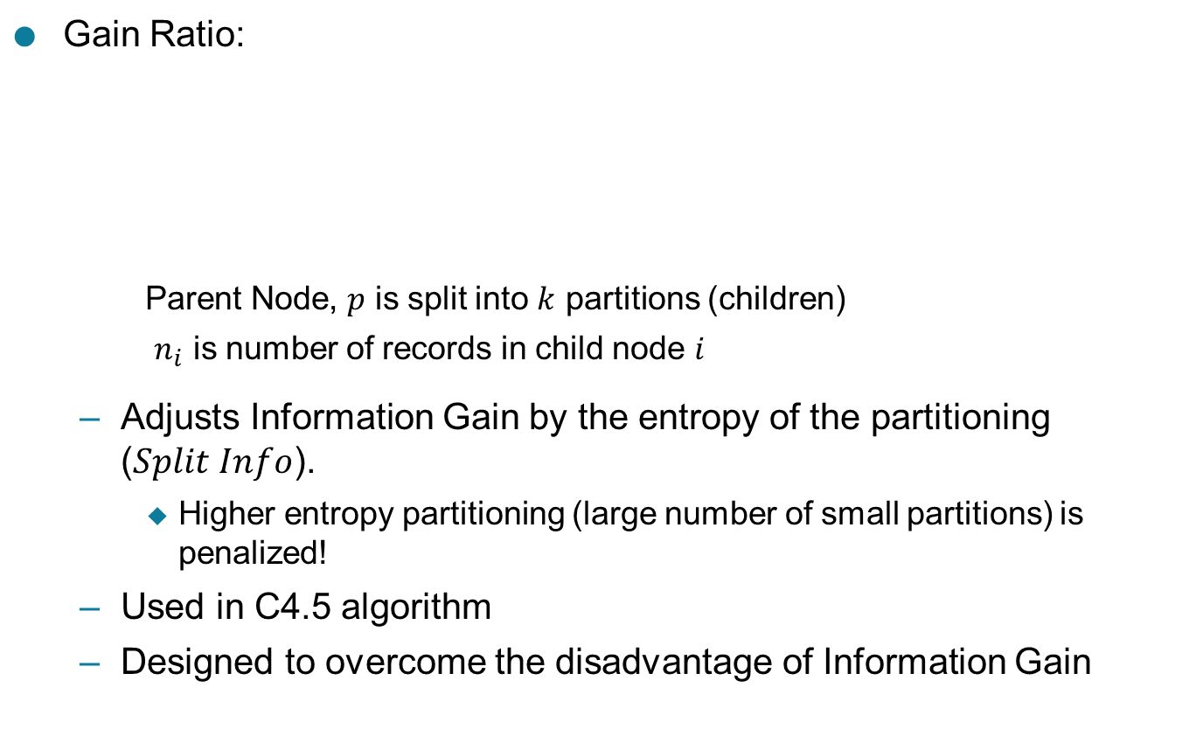
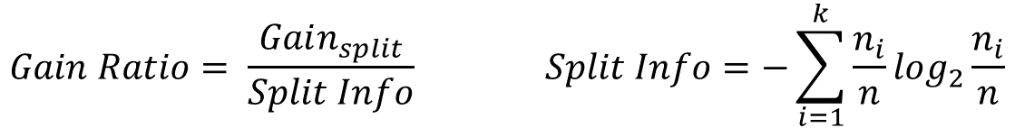
Gain Ratio
Gain Ratio:
Parent Node, $p$ is split into $k$ partitions (children)
$n_{i}$ is number of records in child node $i$
Adjusts Information Gain by the entropy of the partitioning ($Split Info$).
Higher entropy partitioning (large number of small partitions) is penalized!
Used in C4.5 algorithm
Designed to overcome the disadvantage of Information Gain
$$Gain Ratio= \frac{Gain_{split}}{Split Info} Split Info=−\sum_{i=1}^{k}{\frac{n_{i}}{n}log_{2}}\frac{n_{i}}{n}$$
Notes:
There are two strategies for overcoming this problem. The first strategy is
to restrict the test conditions to binary splits only. This strategy is employed
by decision tree algorithms such as CART. Another strategy is to modify the
splitting criterion to take into account the number of outcomes produced by
the attribute test condition. For example, in the C4.5 decision tree algorithm,
a splitting criterion known as gain ratio is used to determine the goodness
of a split. This criterion is defined as follows:

Slide 52

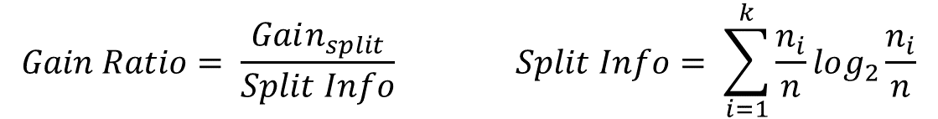
Gain Ratio
Gain Ratio:
Parent Node, $p$ is split into $k$ partitions (children)
$n_{i}$ is number of records in child node $i$
$$Gain Ratio= \frac{Gain_{split}}{Split Info} Split Info= \sum_{i=1}^{k}{\frac{n_{i}}{n}log_{2}}\frac{n_{i}}{n}$$
SplitINFO = 1.52
SplitINFO = 0.72
SplitINFO = 0.97
Notes:
Impurity measures such as entropy and Gini index tend to favor attributes that
have a large number of distinct values.
Here, Split Info = −k
i=1 P(vi) log2 P(vi) and k is the total number of splits.
For example, if each attribute value has the same number of records, then
∀i : P(vi) = 1/k and the split information would be equal to log2 k. This
example suggests that if an attribute produces a large number of splits, its
split information will also be large, which in turn reduces its gain ratio.

Slide 53

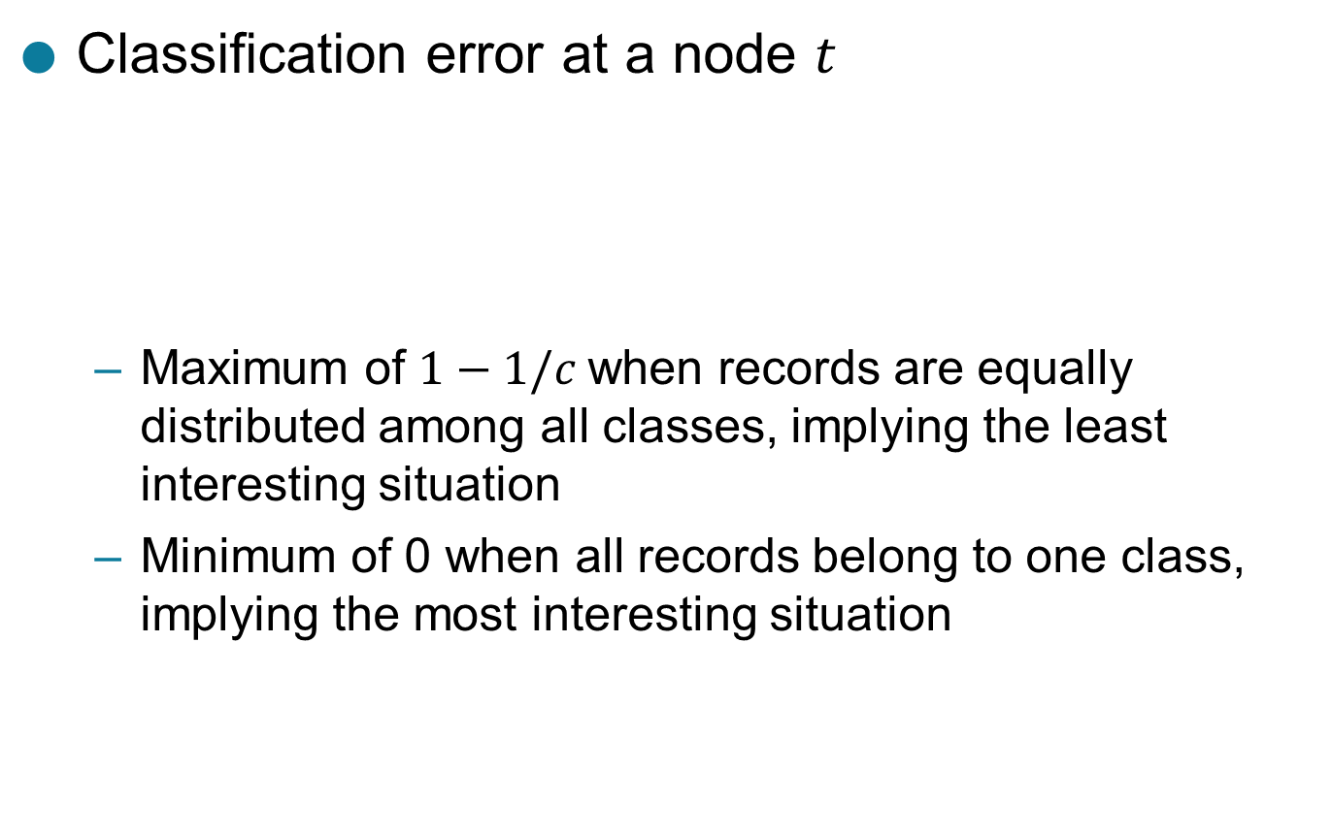
Measure of Impurity: Classification Error
Classification error at a node $t$
Maximum of $1−1/c$when records are equally distributed among all classes, implying the least interesting situation
Minimum of 0 when all records belong to one class, implying the most interesting situation
$$Error\left(t\right)=\underset{ i}{1 −max}⁡[p_{i}\left(t\right)]$$

Slide 54

Computing Error of a Single Node
$$Error\left(t\right)=\underset{ i}{1 −max}⁡[p_{i}\left(t\right)]$$
P(C1) = 0/6 = 0 P(C2) = 6/6 = 1
Error = 1 – max (0, 1) = 1 – 1 = 0
P(C1) = 1/6 P(C2) = 5/6
Error = 1 – max (1/6, 5/6) = 1 – 5/6 = 1/6
P(C1) = 2/6 P(C2) = 4/6
Error = 1 – max (2/6, 4/6) = 1 – 4/6 = 1/3

Slide 55
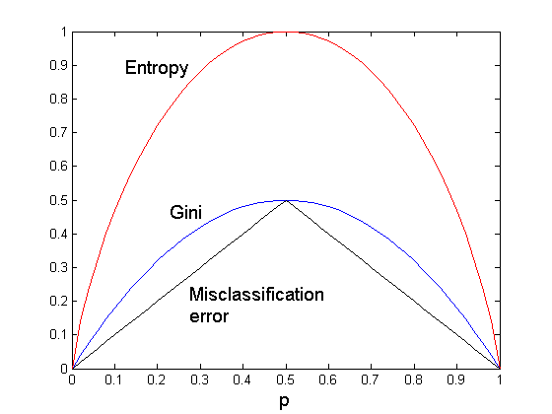
Comparison among Impurity Measures
For a 2-class problem:

Slide 56
Misclassification Error vs Gini Index
A?
Yes
No
Node N1
Node N2
Gini(N1) = 1 – (3/3)² – (0/3)² = 0
Gini(N2) = 1 – (4/7)² – (3/7)² = 0.489
Gini(Children) = 3/10 * 0 + 7/10 * 0.489 = 0.342
Gini improves but error remains the same!!
Notes:
Why is entropy preferred over misclassification error to perform decision tree splitting?

Slide 57
Why?
Entropy is the phenomenon of information theory used to calculate uncertainty or impurity in information
The misclassification loss computes the fraction of misclassified samples
Therefore, compared to entropy, the misclassification loss is not sensitive to changes in the class probabilities, due to which entropy is often used in building the decision tree for classification.

Slide 58
Misclassification Error vs Gini Index
A?
Yes
No
Node N1
Node N2
Misclassification error for all three cases = 0.3 !

Slide 59
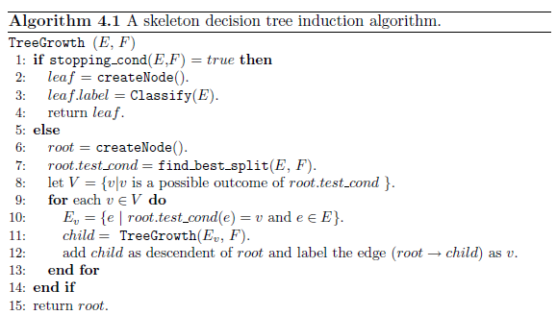
Decision Tree Algorithm
Notes:
The input to this algorithm consists of the training records
E and the attribute set F. The algorithm works by recursively selecting the
best attribute to split the data (Step 7) and expanding the leaf nodes of the

Slide 60
Algorithm
The createNode() function extends the decision tree by creating a new node. A node in the decision tree has either a test condition, denoted as node.test cond, or a class label, denoted as node.label.
The find best split() function determines which attribute should be selected as the test condition for splitting the training records. As previously noted, the choice of test condition depends on which impurity measure is used to determine the goodness of a split. Some widely used measures include entropy, the Gini index, and the χ2 statistic.

Slide 61
Algorithm Continued :
The Classify() function determines the class label to be assigned to a leaf node. For each leaf node t, let p(i|t) denote the fraction of training records from class i associated with the node t. In most cases, the leaf node is assigned to the class that has the majority number of training records.
The stopping cond() function is used to terminate the tree-growing process by testing whether all the records have either the same class label or the same attribute values. Another way to terminate the recursive function is to test whether the number of records have fallen below some minimum threshold.
Notes:
After building the decision tree, a tree-pruning step can be performed
to reduce the size of the decision tree. Decision trees that are too large are
susceptible to a phenomenon known as overfitting

Slide 62
Decision Tree Based Classification
Advantages:
Relatively inexpensive to construct
Extremely fast at classifying unknown records
Easy to interpret for small-sized trees
Robust to noise (especially when methods to avoid overfitting are employed)
Can easily handle redundant attributes
Can easily handle irrelevant attributes (unless the attributes are interacting)
Disadvantages: .
Due to the greedy nature of splitting criterion, interacting attributes (that can distinguish between classes together but not individually) may be passed over in favor of other attributed that are less discriminating.
Each decision boundary involves only a single attribute

